Slide 1

start with us - - - - finish with them.
Notes:
Areas of Study overview

Slide 2
What is a "Transfer Degree"?
Start with us, finish with them!
Seattle Colleges offers two broad categories of degrees: transfer and professional/technical.
Professional/technical degrees are designed to lead straight to a career after completion. More hands-on and skills-based.
Transfer degrees are designed to prepare you to transfer to a 4-year college or university to complete your bachelor's degree. More general education and major-preparation classes.
Paths to graduation
Professional/technical degrees
90 credits (approximately 2 years) --> graduate with associate degree --> start your career
Transfer degrees
90 credits (approximately 2 years) --> graduate with associate degree -->
transfer to 4 year college/university -->graduate with bachelor's degree

Slide 3
Transfer Degrees
Associate of Arts (AA-DTA)
Built in collaboration with Washington Universities
90 credits
3 Sections:
  Basic Requirements (English and Math)
  Distribution Requirements
  Electives
DTA = Direct Transfer Agreement, but doesn’t necessarily mean “guaranteed admission”
Where is this degree offered?
All three Seattle Colleges

Slide 4
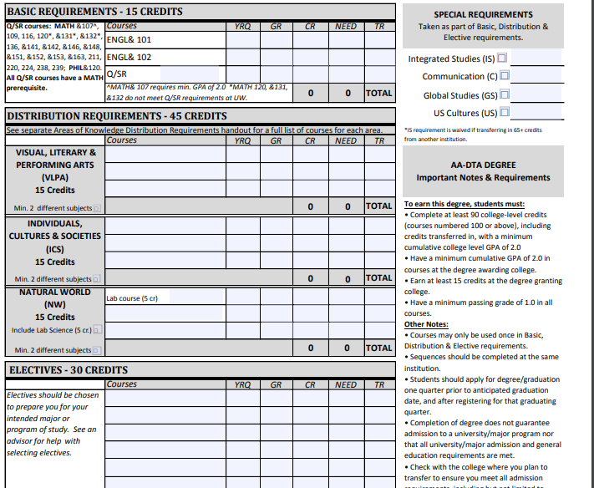
About the AA-DTA Degree (All Seattle Colleges)
This is Washington’s most general, broad transfer degree. It’s built to help you meet as many pre-requisites as possible for most 4-year degree programs.

Slide 5
Transfer Degrees
Associate of Fine Arts (AFA)
Designed for students pursuing the fine arts and/or transferring to a Bachelor in Fine Arts, or a BA with a Fine Arts major. Requirements may vary depending on the transfer institution and students may need additional general education courses.
90 credits
Degree components include:
  General Education
  Art classes (including Art History and Studio Art)
  Portfolio
North Seattle College also offers a Certificate in Fine Art and a Certificate in Jewelry Design. These certificates are designed to fit within the larger AFA degree.
Where is this degree offered?
North Seattle College

Slide 6
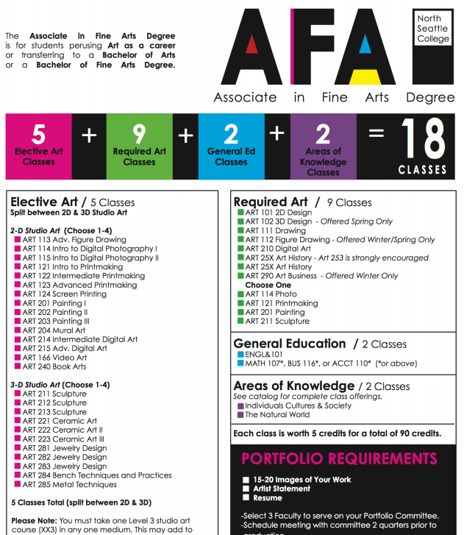
About the AFA Degree (North)
The Associate of Fine Arts (AFA) degree in Art is designed for students pursuing the fine arts and includes a stackable Certificate of Fine Art (CFA).

Slide 7

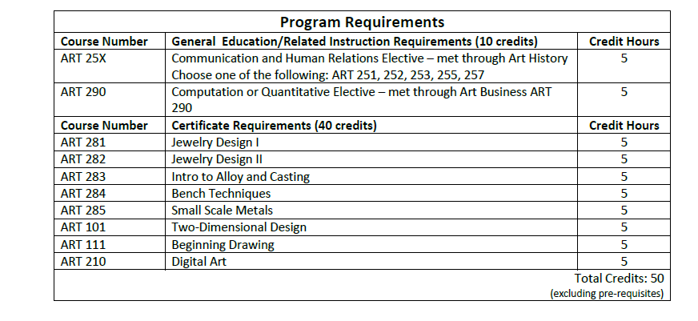
Certificate of Jewelry Design (North)

Slide 8
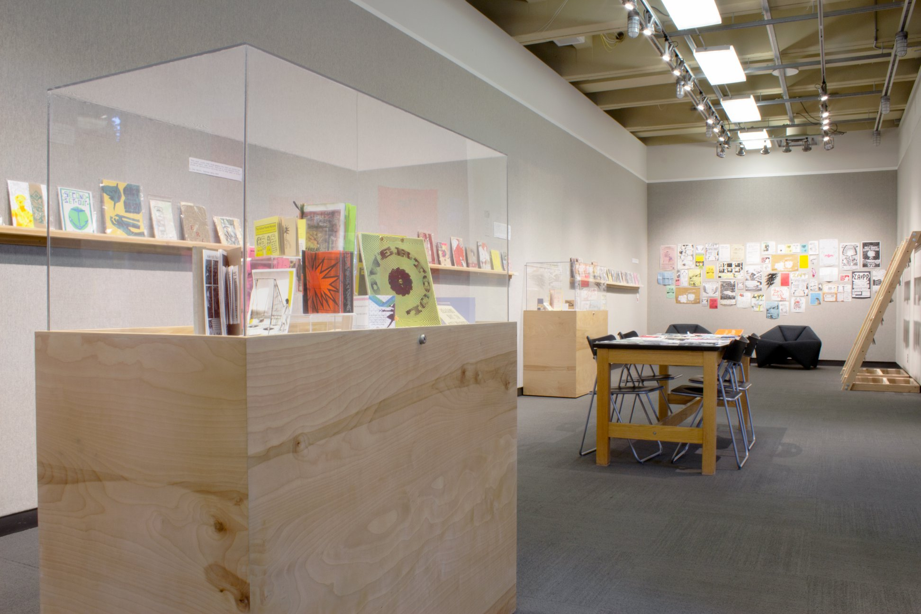
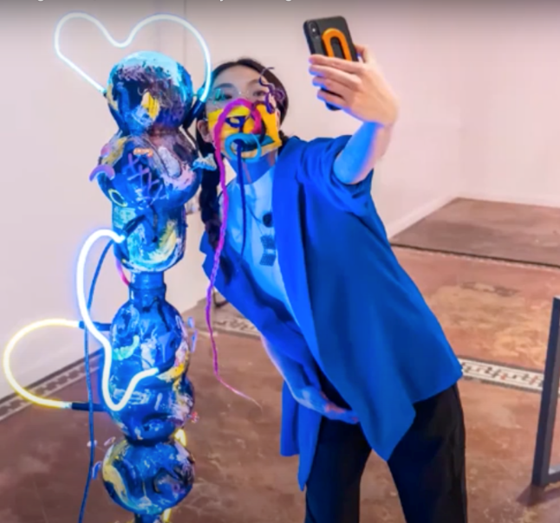
North Seattle College Art Gallery
Ceramics faculty Ling Chun – video still from the visiting lecture series hosted by NSC Art Gallery
Gallery installation for the Z.A.P.P. exhibition of zines
https://artgallery.northseattle.edu/

Slide 9
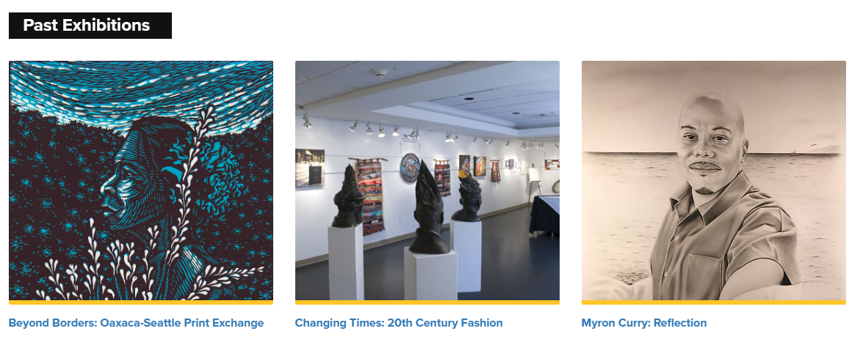
Seattle Central’s M. Rosetta Hunter Art Gallery
https://artgallery.seattlecentral.edu/

Slide 10

South Seattle College Art Gallery
https://southseattle.edu/student-life/art-gallery

Slide 11
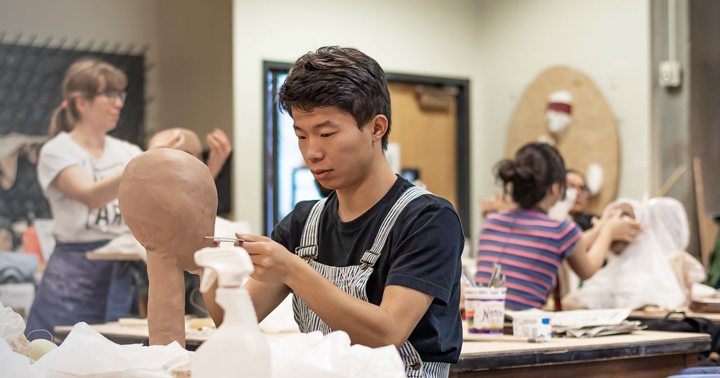
Student Work
Students working in Paula Rebsom’s ceramic sculpture course at North Seattle College

Slide 12
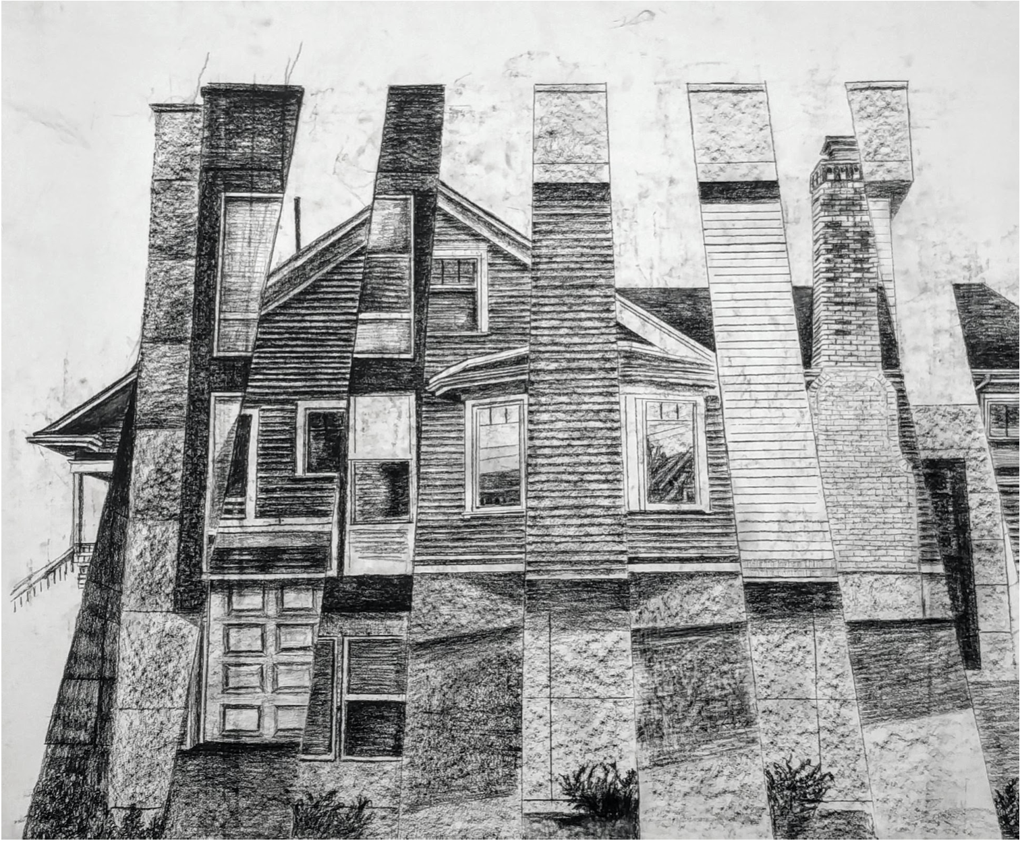
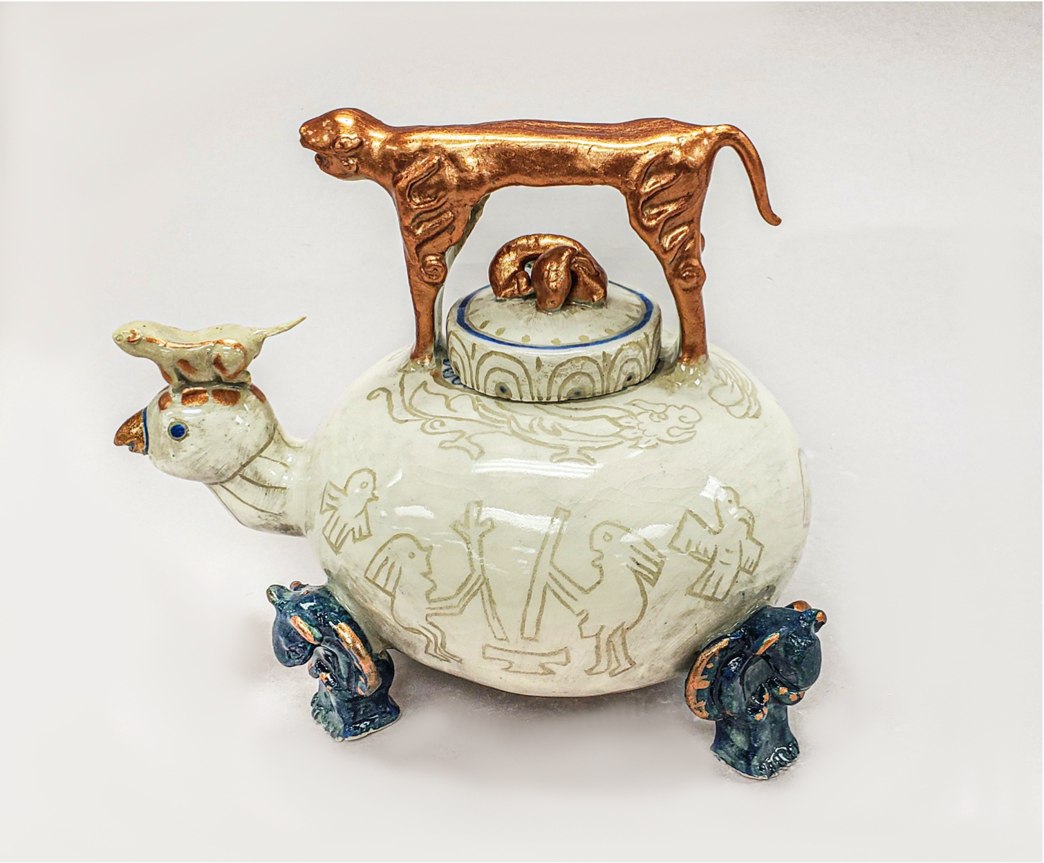
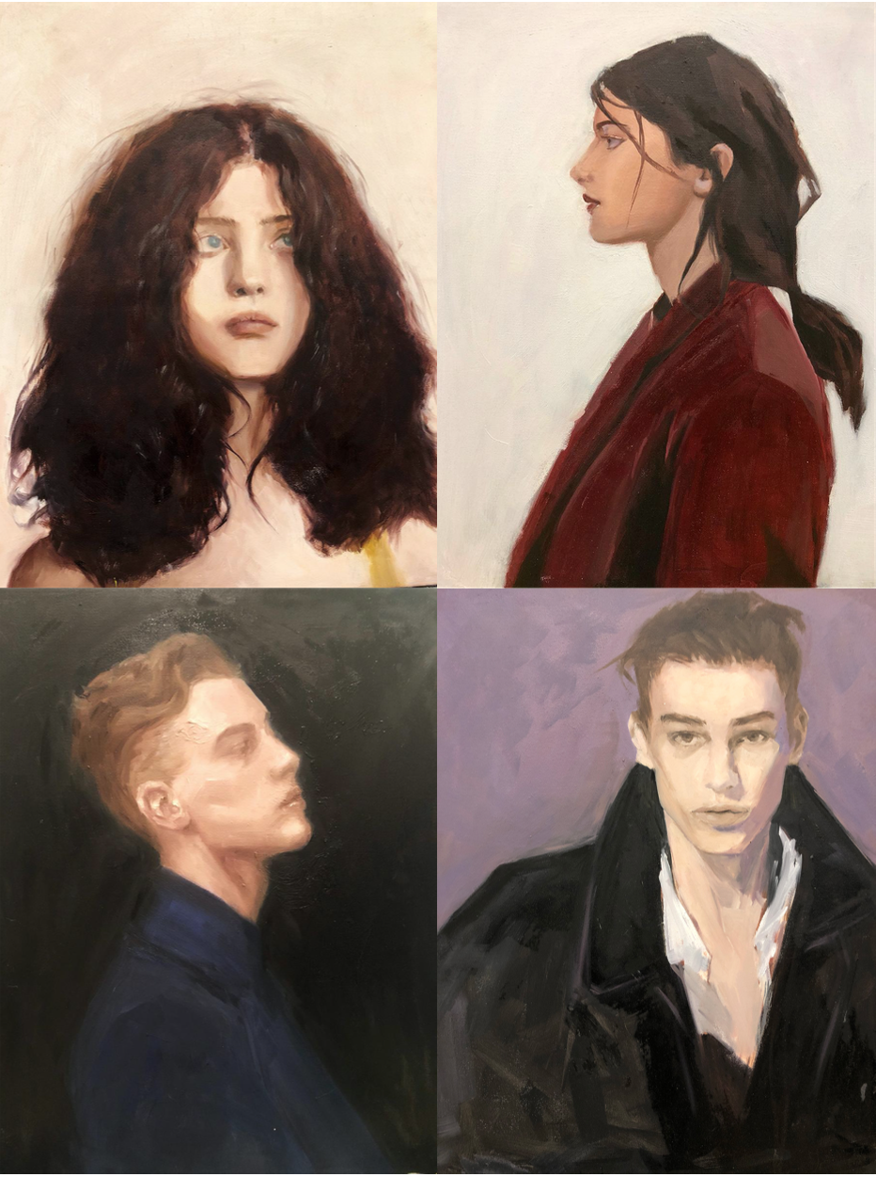
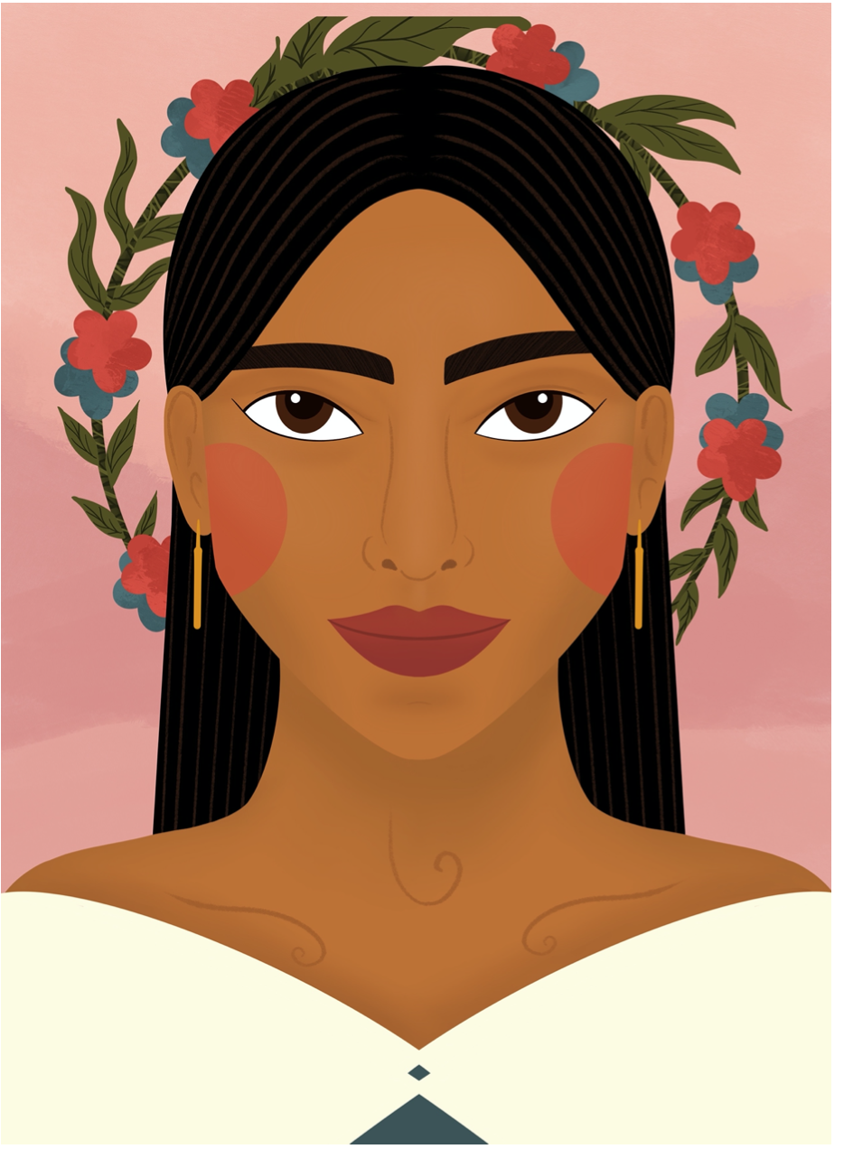
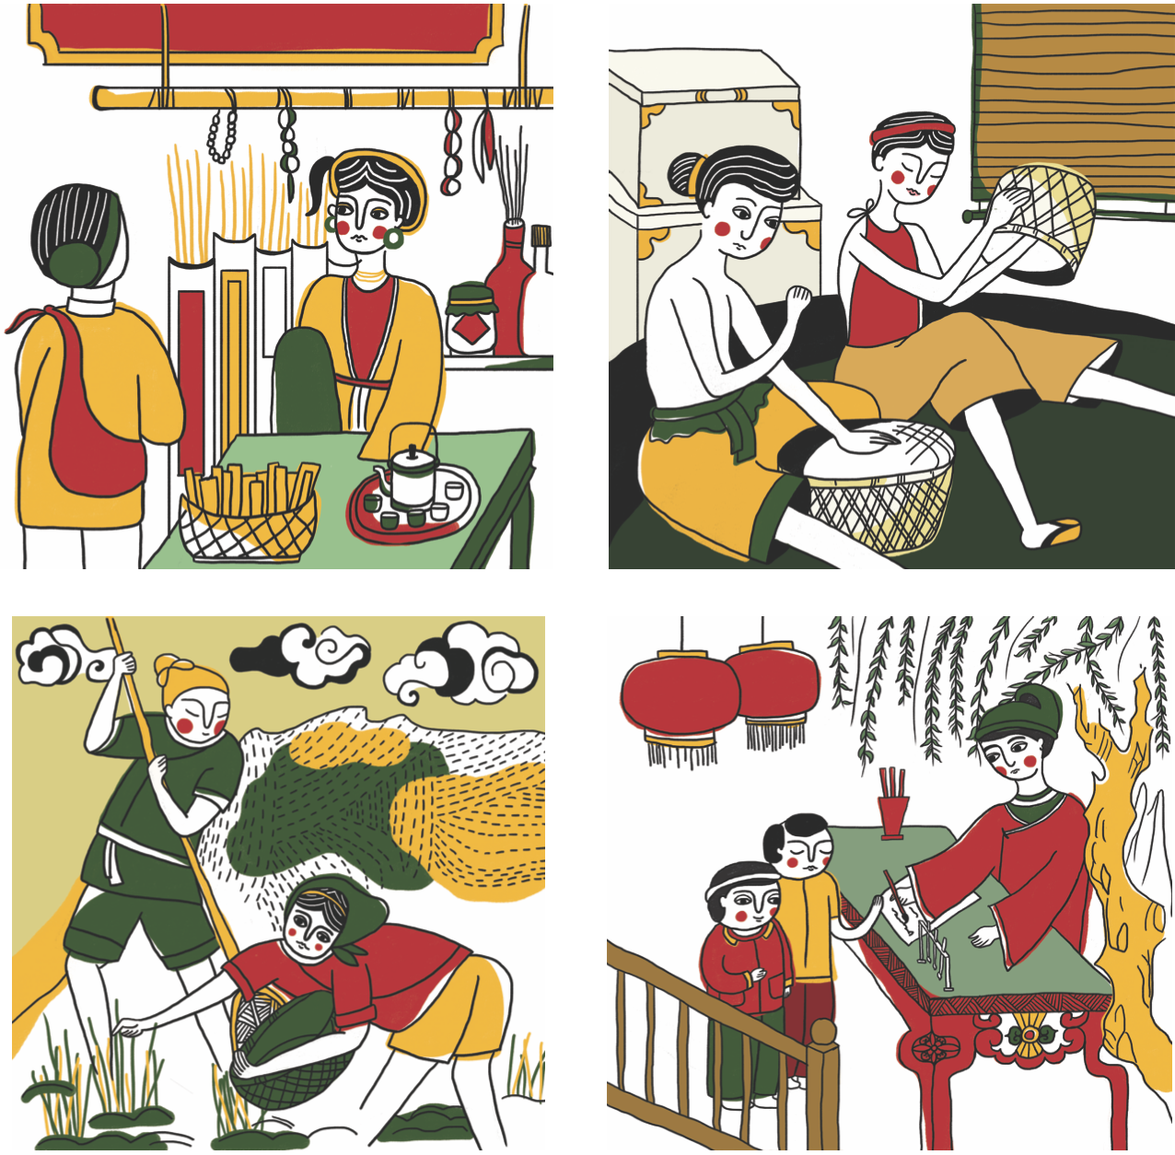
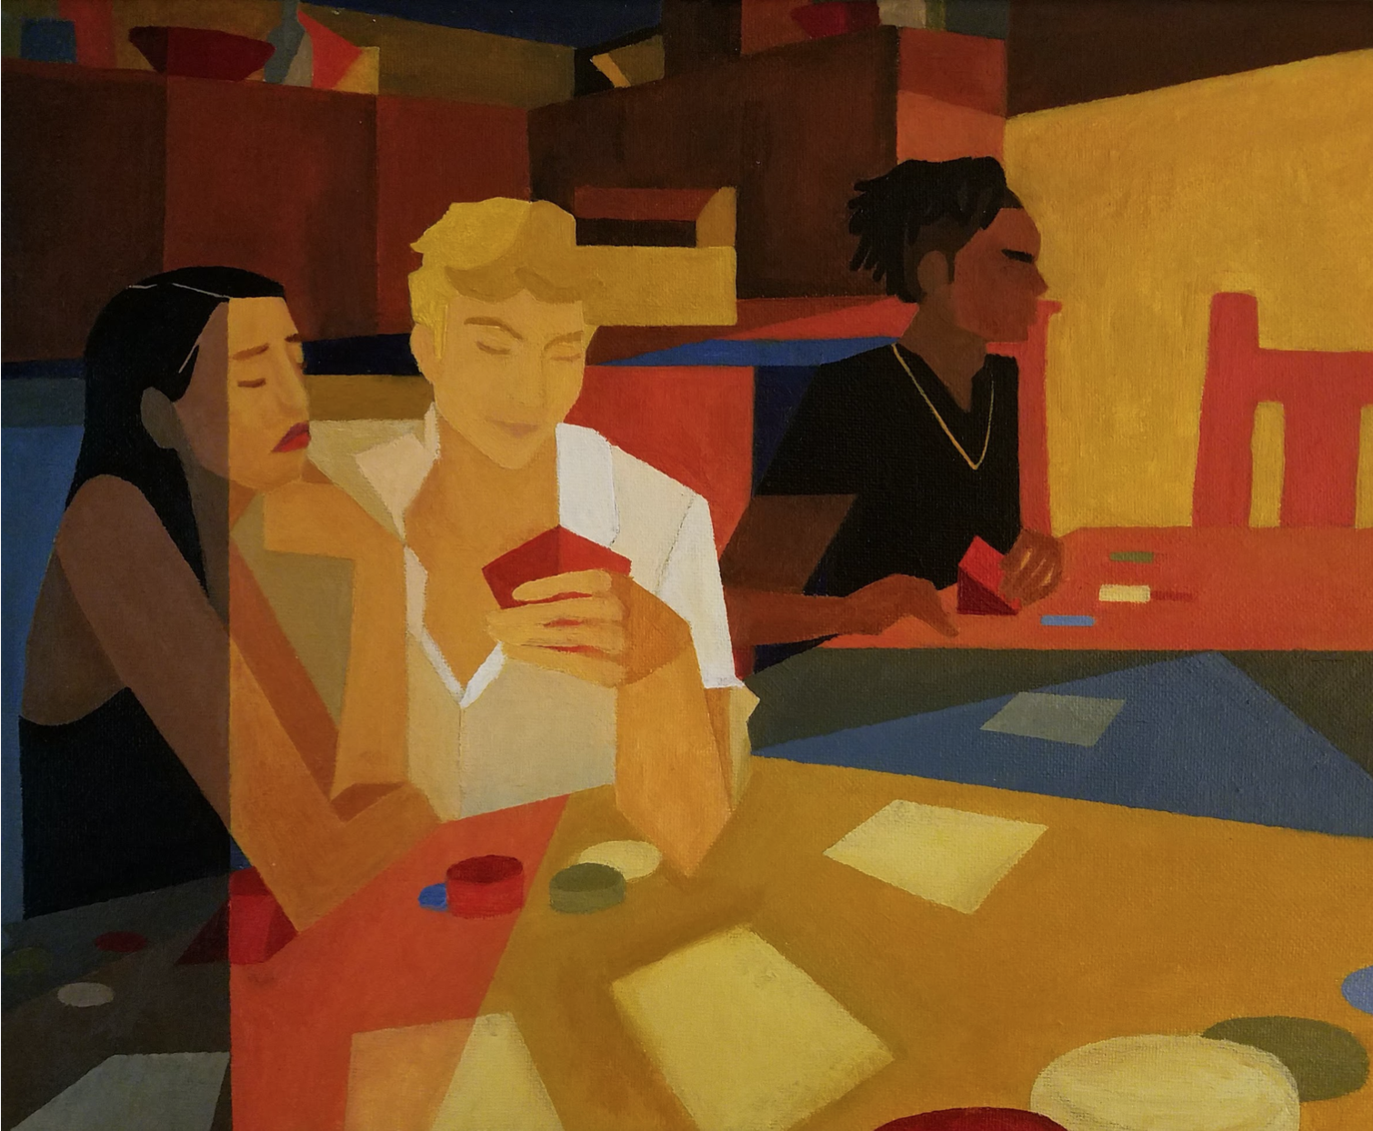
Student Work
Maria Paramonova, North Seattle College
Duong Thuy Bui, South Seattle College
Cassie (Ggotbyeol) Kim, Seattle Central College
Katelynn Oleson, Seattle Central College
Ngoc Diep-Phuong Doan, South Seattle College
Maria Hernandez, North Seattle College

Slide 13
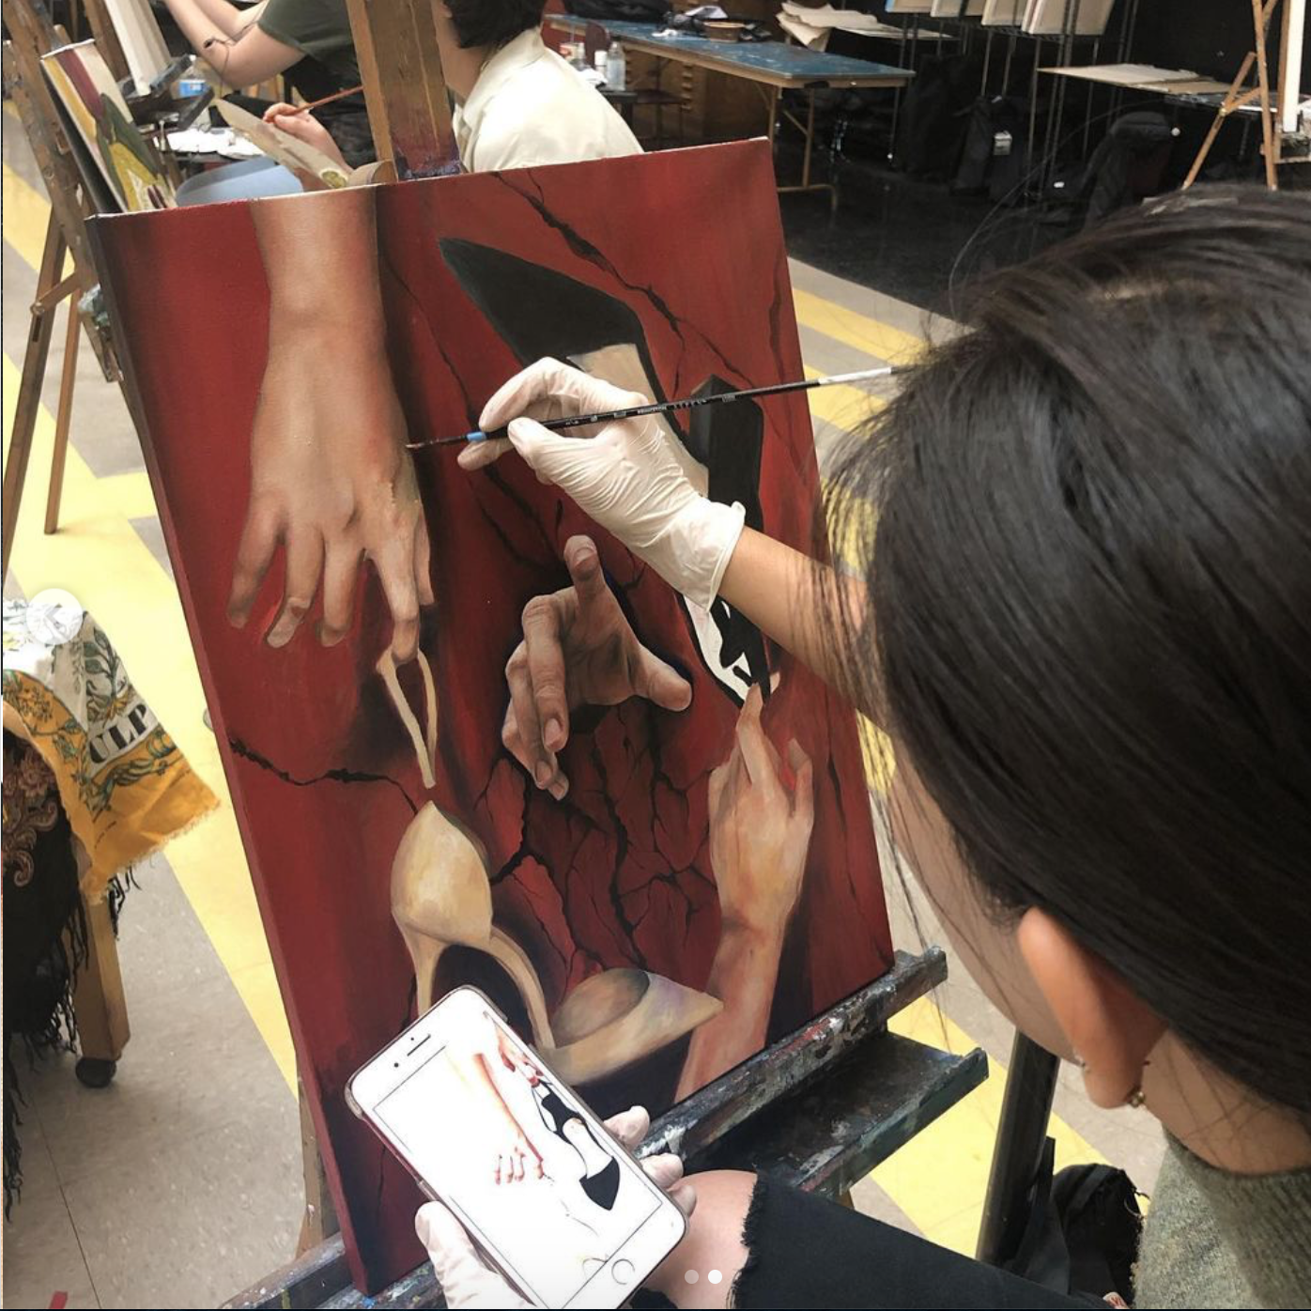
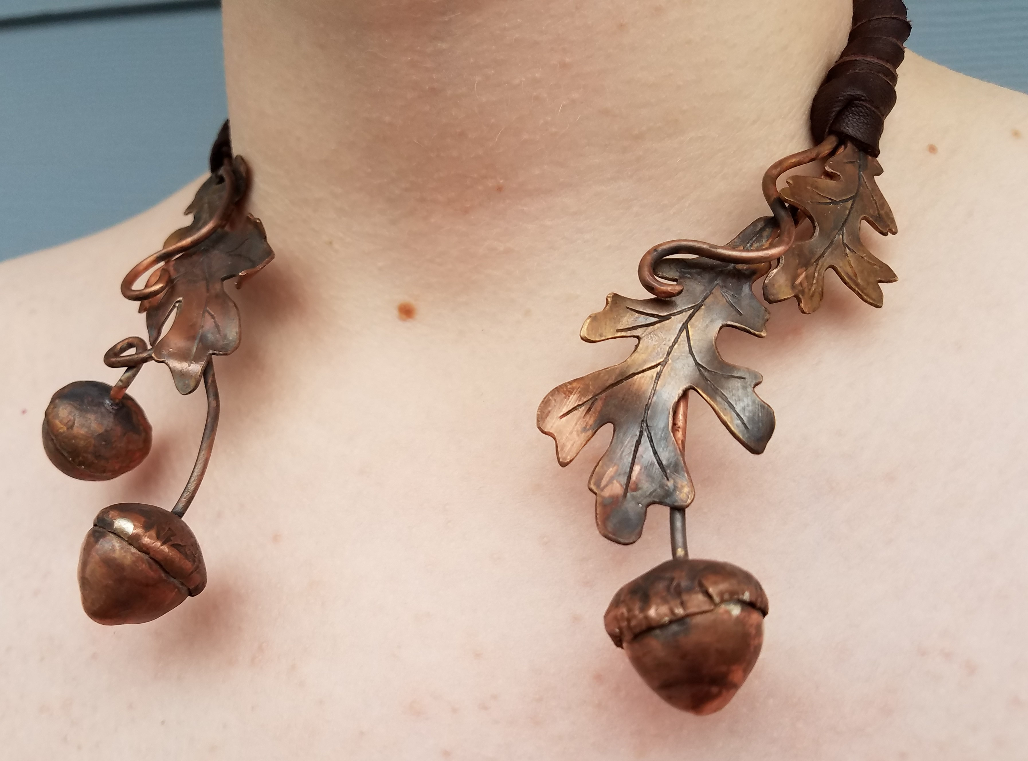

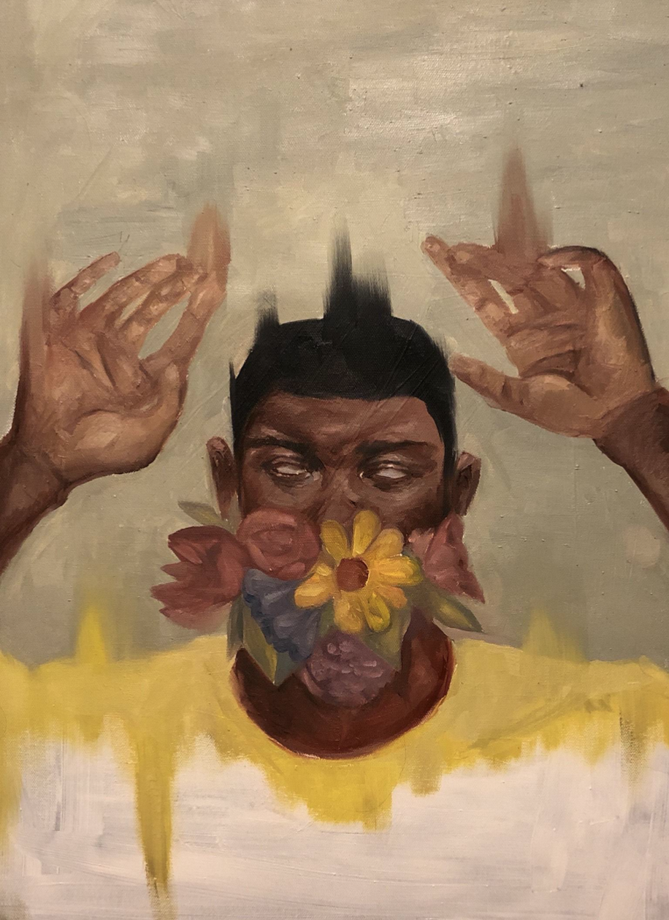

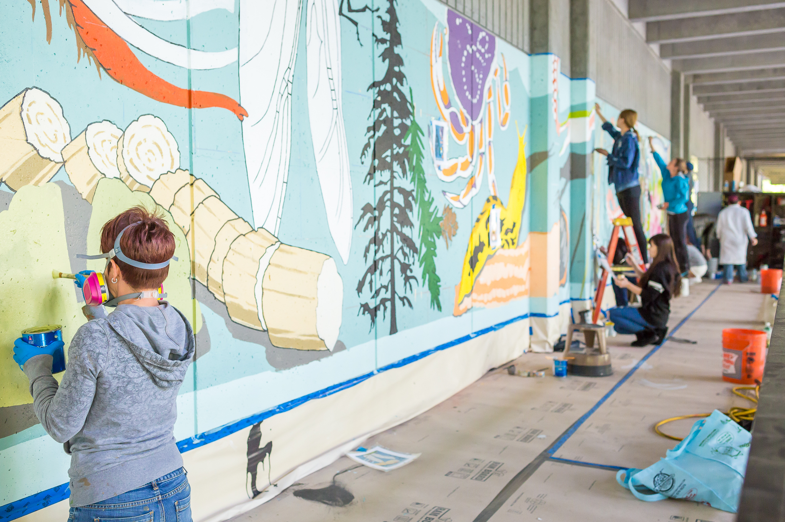
Student Work
Cas Alexander, Jewelry at North
Yuchuan Karber, Printmaking at North
Tam Pham Painting at Seattle Central
Students in North’s mural art class
Ksenia Gotham, Digital Art at South
Huong Thu Trang, Central

Slide 14

Find us on Facebook, Instagram, YouTube
@northseattlecollegeartgallery
@sscartgallery
@nscartdept
@nscartgallery
@scc_artclass
@southseattlecollegeartgallery
- North Seattle College Art Gallery
- Art Gallery South Seattle College
- Seattle Central College

Slide 15
Get the most from your degree
Transfer Timeline
0-18 credits: Choose and Explore
  Explore majors
  Attend Transfer Fairs
  Create your Ed Plan
19-44 credits: Plan for Your Future
  Meet with 4-year college advisors
  Make sure you understand admission requirements
45-74 credits: Apply to Your Chosen Schools
  Work with your Seattle Colleges advisor to update your Ed Plan
  Work on application materials (college application, personal statement, etc.)
75-90 credits: Get Ready to Transfer
  Apply for your degree at Seattle Colleges
  Send official transcripts to your university

Slide 16
Where can I transfer?
Anywhere!
You can transfer to any 4-year school you choose.
  Completing a transfer degree does not guarantee admission at all colleges/universities. You are still required to apply to the schools you chose.
You’ll want to work closely with your Seattle College advisor and your intended 4-year college or university to make sure you’re taking classes that will transfer with ease.
You can make the process easier
Make sure you find out if your 4-year school has any special admission or graduation requirements (eg: taking world language classes or taking certain pre-requisites so you can enroll in your 300+ level courses right away).
As soon as you know where you want to transfer, tell your Seattle Colleges advisor the school and the major so we can help you plan your classes for your associate degree to fit your transfer needs.

Slide 17
Careers and Transfer Opportunities in the Arts
Our graduates have successfully gone on to get degrees of higher learning at many institutions, including University of Washington, California College of the Arts, Pacific Northwest College of Art, School of the Art Institute Chicago, Rhode Island School of Design, San Diego State University, Western Washington University and have received scholarships and opportunities at many other programs such as Penland School of Craft and Pratt Fine Art Center.
Career Opportunities
Practicing Studio Artists and Performers
Graphic/Industrial Designers
Small Business Owners/Entrepreneurs
Public Artist/Muralist
Teachers
Art Therapists
Artist Assistants
Art Handlers
Curators
Gallery/Museum Assistants
Arts Administrators
Jewelers, Gold/Silversmiths and Stone Setters
Jewelry Business Owners/Entrepreneurs
Graphic/Web/Industrial Designers
Commercial Photographer
Illustrators

Slide 18
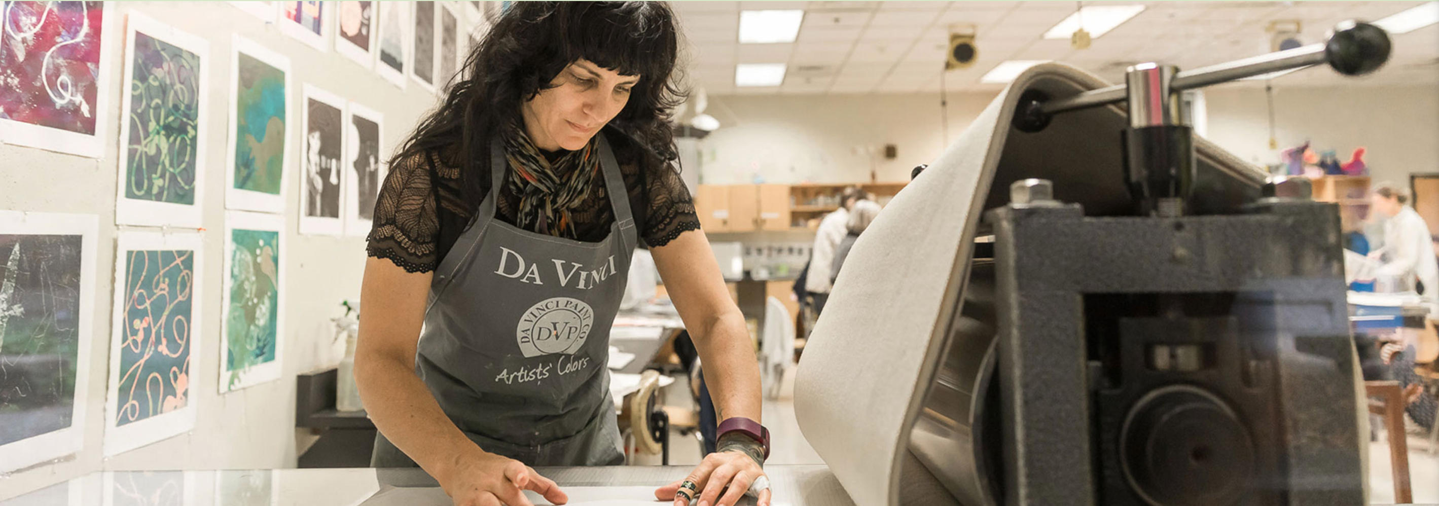
Q & A
Most important next step:
Work closely with your advisor to build an Educational Plan that will map all the classes you need to take.
What questions do you have?
Student Nico Lund working in the North Seattle College Printmaking Studio

Slide 19

Return to Main Session
(select “Leave Breakout Room” to return)

Slide 20
Extra blank slide (if needed)

